Slide 1
NLP: Sentiment Analysis
Analyzing Product Sentiments from Tweets
Sung Bae

Slide 2
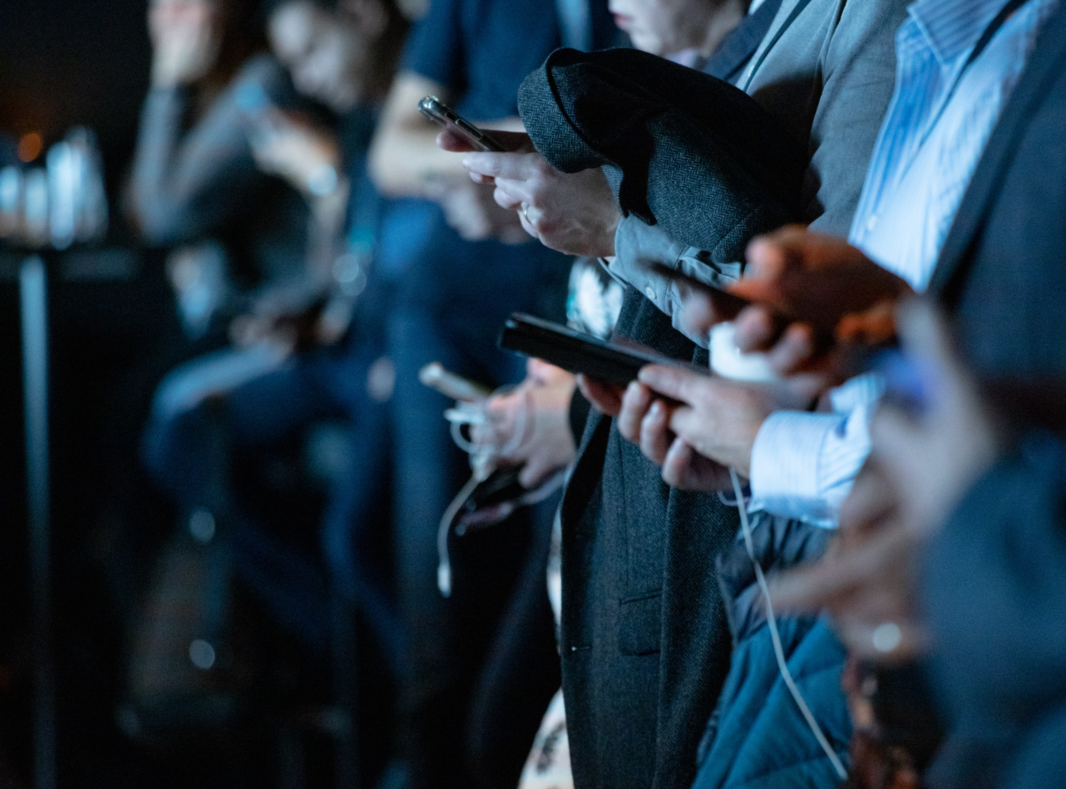
The Importance
of
Communication
“Our beliefs and perceptions of reality, and the choices we make, are largely conditioned on how others see and evaluate the world”
- Bing Liu , University of Illinois, Chicago
Notes:
camilo jimenez
https://unsplash.com/photos/qZenO_gQ7QA
https://www.mobilecon2012.com/the-evolution-of-communication-through-the-centuries/

Slide 3
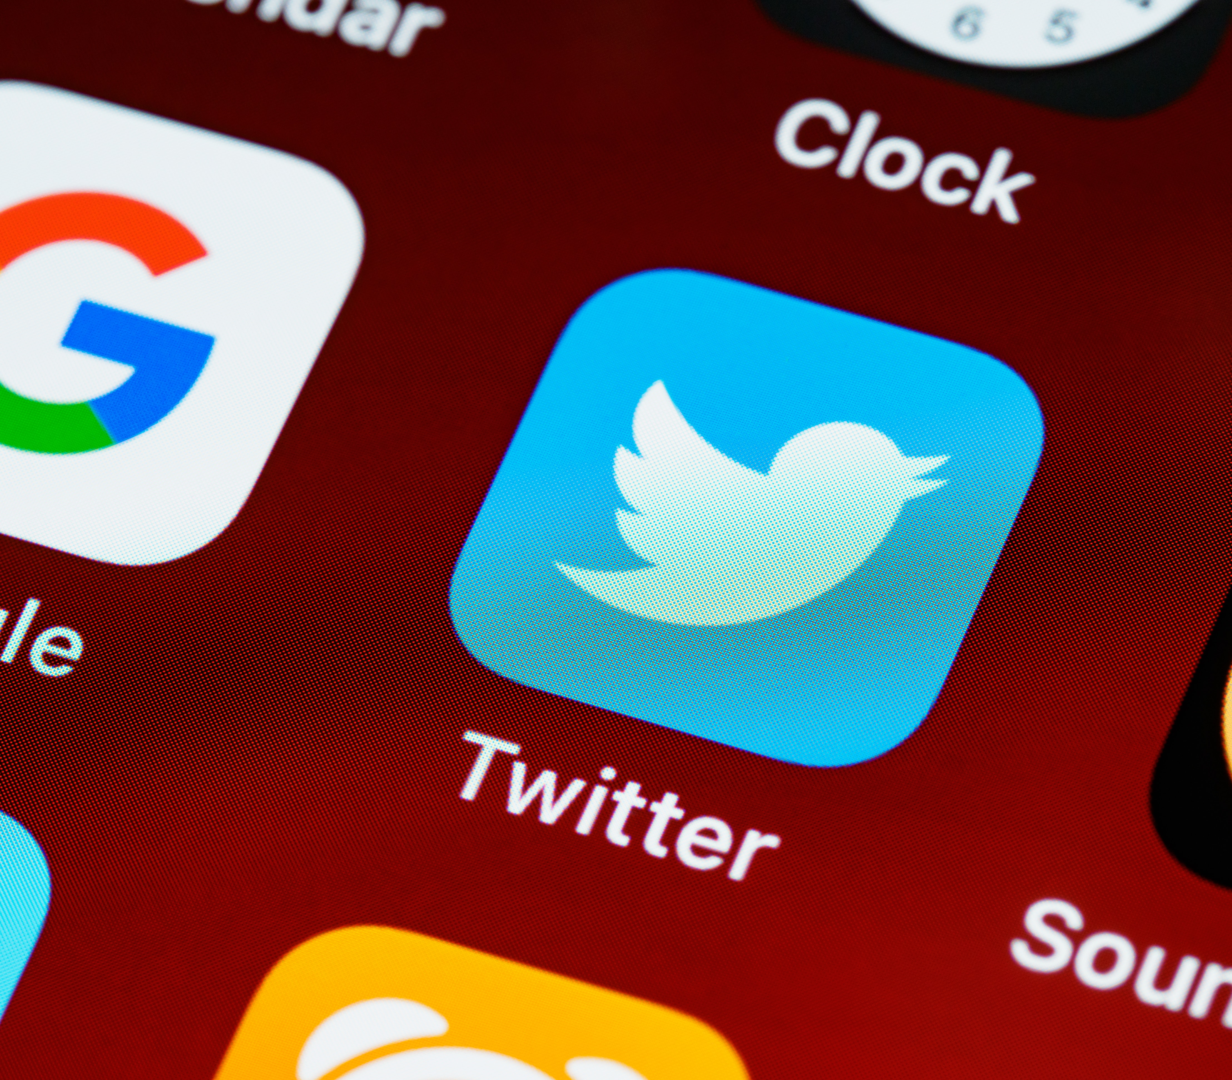
Twitter
145 million daily users
22% of Americans are on Twitter
500 million tweets sent each day
65.8% of US companies use Twitter for marketing
80% of Twitter users have mentioned a brand in a tweet
77% of Twitter users feel more positive when their tweet has been replied to.
Notes:
https://unsplash.com/photos/ulRlAm1ITMU

Slide 4
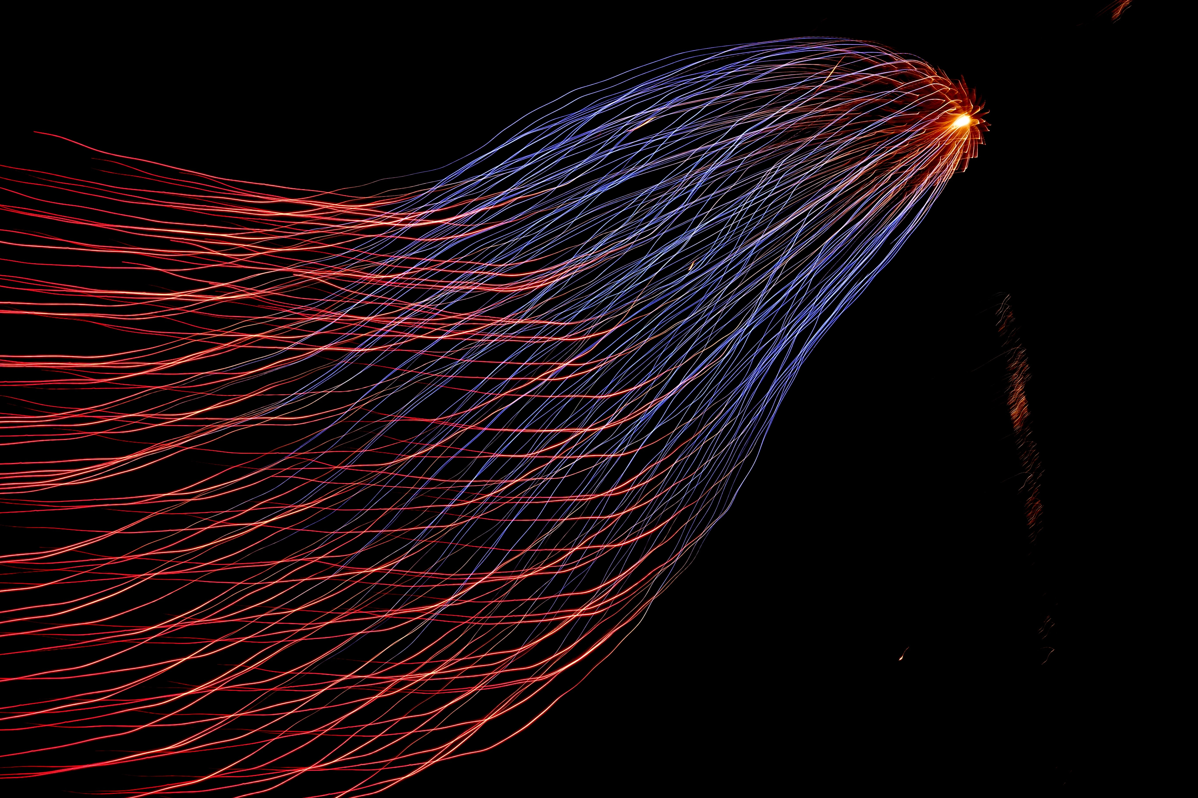
Goals
Create a model that can
[1] Flag the company when there is a negative tweet about their specific product
[2] Correctly identify which product
[3] Correctly classify tweets into negative, neutral, and positive sentiments

Slide 5
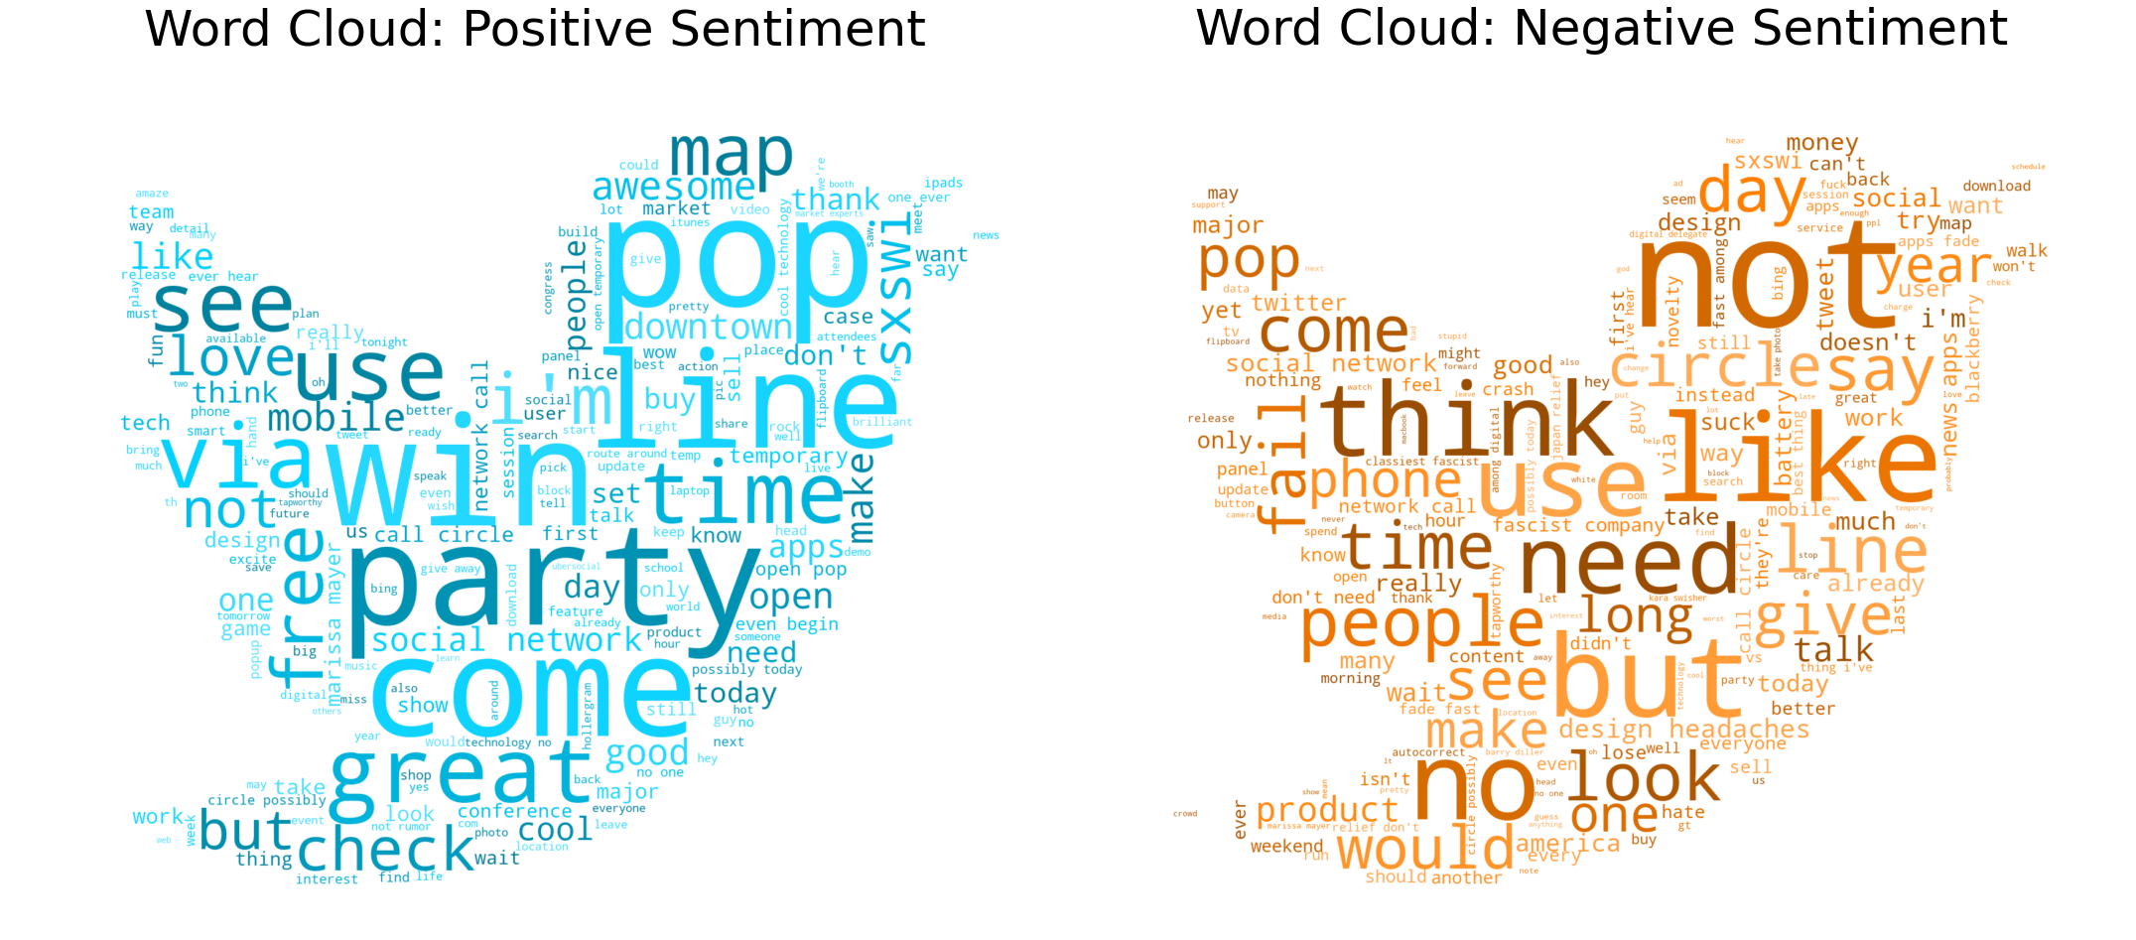
EDA: Positive and Negative Sentiments
Positive Sentiments
Negative Sentiments
Notes:
image source: https://blog.mellanox.com/2019/05/an-out-of-band-malware-detection-with-mellanox-bluefield/

Slide 6
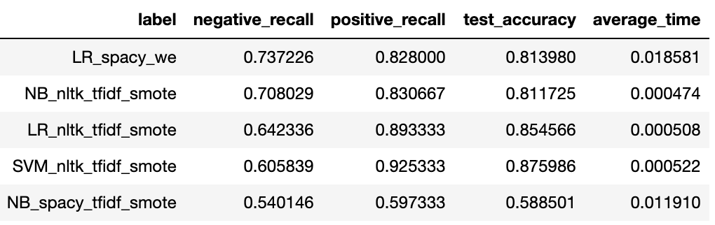
Binary Models Result
Best Negative Recall:
[LR_spacy_we]
Logistic Regression - Word embedding
Best Computing Time:
[NB_nltk_tfidf_smote]
Naïve-Bayes’ – TF-IDF with SMOTE

Slide 7
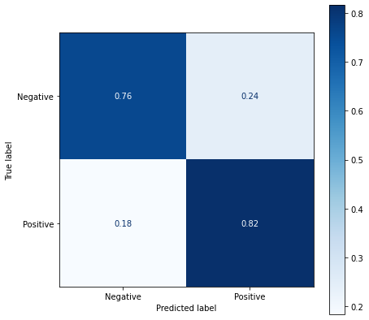
Model Results: Binary (Positive vs. Negative)
Overall Accuracy = 81 %
76% of negative sentiment
tweets were correctly identified
82% of positive sentiment
tweets were correctly identified

Slide 8
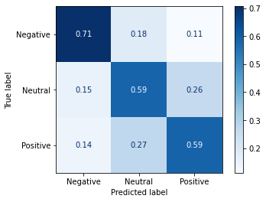
Model Results: Multiclass
Overall Accuracy = 60 %
71% of negative sentiment
tweets were correctly identified
59% of neutral sentiment
tweets were correctly identified
59% of positive sentiment
tweets were correctly identified

Slide 9
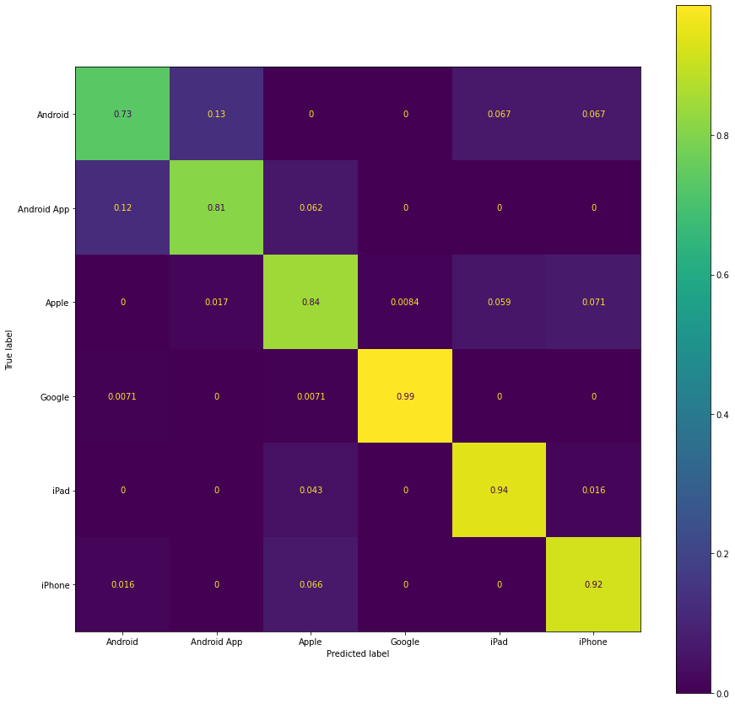
Model Results: Product Predictor
Overall Accuracy = 91 %
Comment:
Products under same brand are confused by the model
Example.
Android and Android App

Slide 10
Conclusion
Our final models can
Binary Sentiment
81% accuracy with 76% negative sentiment recall
Multiclass Sentiment
60% accuracy with 71% negative sentiment recall
Product Predictor
91% of accuracy

Slide 11
Recommendations 1 – Binary Sentiments
- Multilcass not only complicates the model itself, but also it dilutes negative and positive sentiments together, therefore, we recommend using binary sentiment classification model

Slide 12
Recommendations 2 – Models
1. Best Negative Sentiment Identifier:
logistic regression using word-embedding model [74%]
Pros: Cons:
Best Negative Recall (74%)
Good Overall Accuracy (81%)
Takes longer time (40x longer)
2. Best Computing Time Sentiment Identifier:
Naïve Bayes’ using TF-IDF model with SMOTE
Pros: Cons:
Best Computing Time
Good Negative Recall (70.8%)
Uses SMOTE – Synthetically generated data
*Further studies need to be done for consistency

Slide 13
Future Direction
[1] Further data acquisition:
Due to imbalance in data, our model suffered. Acquiring similar datasets with more balanced classes would increase our model's performance and reliability.
[2] Real time Twitter analysis
Have this model refined and put in a production so that it can monitor tweets real time and analyze and negative flags about any particular product.
[3] Research various costs between models
Different models have different strengths and weaknesses, and we believe researching different costs including computing and labor costs using different models would allow us to choose a better model
[4] Try different NLP techniques
There are so many different NLP techniques and they are growing due to works of so many different research entities. It would be very valuable to try different approach including skip-gram and even deep learning NLP for this project.

Slide 14
Thank you for listening

Slide 15
Appendix

